Slide 1

Gas Turbine Model Based Controls
Prabhanjana Kalya

Slide 2
Objectives
The objective of this class is to explain
Where MBC fits in GT controls
Fundamentals of MBC
Advantages of MBC
Cycle versus Combustion Controls
Concept of Load Path and its advancements
Design of some of components of MBC software suite

Slide 3
Introduction
Critical Controls Questions:
What are my operational missions?
What are my operating limits?
What are my effectors / sensors?
What are my control objectives?
What are my noise/disturbance parameters/events?
GT Controls Design:
MBC Overview
MBC control design examples

Slide 4
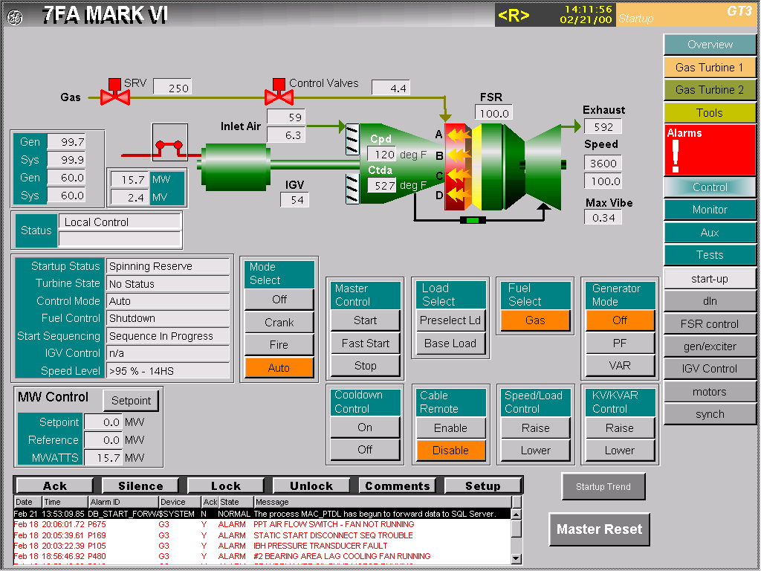
Gas Turbine Missions
What are my operational missions?
Normal Operation
Off
Turning Gear
Crank
Purge
Decel. to Ignition
Fire
Accelerate
Full Speed No Load
Synchronize
Spinning Reserve
Emissions Compliant Turndown
Preselect Load
Base Load
Peak Load
Power Augmentation
Reserve Margin
Unload
Deceleration
Coast Down
Cooldown
Protective Missions
Trip
Shutdown
Runback (normal, fast)
Load Rejection
Step to Spinning Reserve
Fuel Transfers
Gas-to-liquid
Liquid-to-gas
DLN Mode Transfers
Many

Slide 5
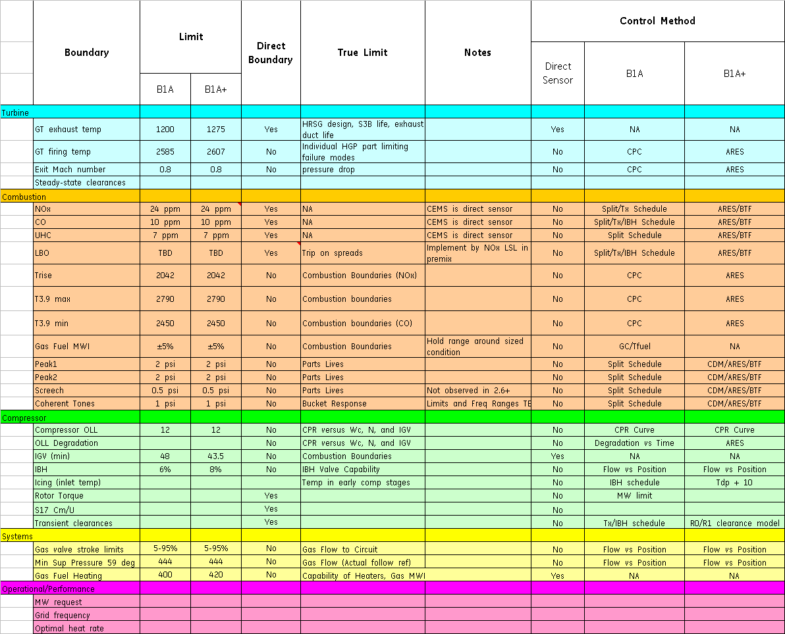
Gas Turbine Limits
What are my operating limits?
(9FB Example)

Slide 6
Gas Turbine Limits
What are my operating limits?
(9FB Example)

Slide 7
MBC in GT Controls
%TNH
MBC
ENABLED
%Load
Prestart
Purge
Fire & Warmup
Acceleration
Sync & Temp Match
Loading

Slide 8
Commonly used GT control loop structure
Sensor outputs
OR
Model outputs
Targets/ Boundary
e
Controller
output
Plant
output
Ref
+
C
G
-
IGV = ## Deg
Ref
+
Controller
output
+
Servo
O/P
Plant
output
C_{o}
Ref
C_{i}
G_{i}
G_{o}
Ex. : Isotherm TTXM = 1200
-
-
Outer Loop
Inner Loop
TTXM
FF output
+
Controller output
FF
+
C
+
G
Targets/ Boundary
-
Sensor outputs
OR
Model outputs
Targets/ Boundary

Slide 9
Gas Turbine Effectors / Sensors
What are my effectors?
What is FSR?
Legend:
ATID
FPG2
FSR stands for Fuel Stroke Reference. FSR is the key fuel control output, designed to be proportional to the fuel heat consumption (BTU/sec). FSR can be thought of as though there it were the position of a single “virtual” gas control valve for the turbine.
(F)
(psig)
IGV
– critical
effectors
SRV
D5
AFPAP
TTXM
– critical
sensors
(inHg)
PM1
(F)
AFPCS
(Units)
(inH2O)
CTIM
PM4
(F)
Comb
~
Other Critical Control Parameters:
TFIRE- Firing temperature
CRT – Combustion reference temperature
TNHCOR – inlet temp-corrected speed
CPR – compressor pressure ratio
C
TNH
T
(%)
DWATT
CPD
(MW)
IGV
(psig)
CTD
TTXM
What are fuel splits?
IBH
(F)
(F)
What is IBH?
A “split” is the proportion of fuel that is delivered to a particular combustion gas passage. In any given DLN system design with N valves, there are N-1 split effectors (since the sum of the fuel is prescribed by FSR, you lose one degree of freedom in splits).
IBH stands for Inlet Bleed Heat. IBH refers to recycling compressor outlet flow back to the compressor inlet. IBH acts to increase air flow through the compressor while decreasing air flow through the gas turbine. The primary use is Compressor surge and icing protection.
What is IGV?
IGV stands for Inlet Guide Vanes. IGV (csrgv signal name) refers to the vanes at the compressor inlet that affect air flow. Opening the IGV increases air flow through the compressor and hence the gas turbine.

Slide 10
Gas Turbine Effectors / Sensors
What are my Sensors?
Legend:
ATID
FPG2
(F)
(psig)
IGV
– critical
effectors
SRV
D5
AFPAP
TTXM
– critical
sensors
(inHg)
PM1
(F)
AFPCS
(Units)
(inH2O)
CTIM
PM4
(F)
Comb
~
Other Critical Control Parameters:
TFIRE- Firing temperature
CRT – Combustion reference temperature
TNHCOR – inlet temp-corrected speed
CPR – compressor pressure ratio
C
TNH
T
(%)
DWATT
CPD
Sensor Signals:
ATID – Ambient Temperature
AFPAP – Ambient Pressure
AFPCS – Inlet Pressure Drop
CTIM – Compressor Inlet Temperature
DWATT – Generator Output
FPG2 – P2 Fuel Pressure
TNH – Shaft Speed as % of Design Point
CPD – Compressor Discharge Pressure
CTD – Compressor Discharge Temperature
TTXM – Exhaust Gas Temperature
IGV
(psig)
(MW)
CTD
TTXM
IBH
(F)
(F)

Slide 11
Quiz - 1
Considering normal operation, which is the first effector(after firing) to use ARES for control ?
FSR
FUEL SPLITS
IGV
IBH
ANSWER:
FUEL SPILITS
5 seconds after ARES is enabled Fuel splits are scheduled as a function of CRT (T3.9)

Slide 12
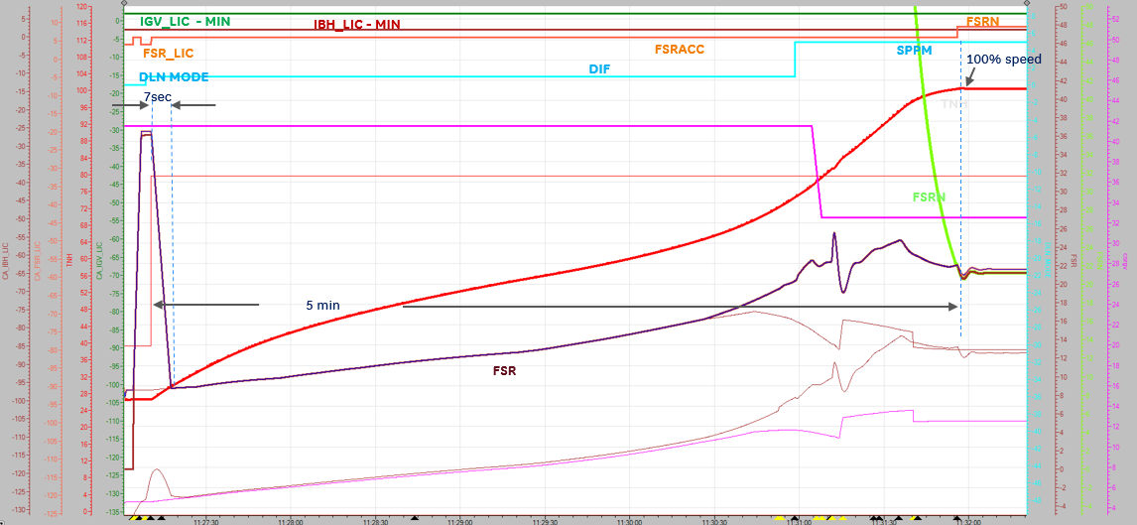
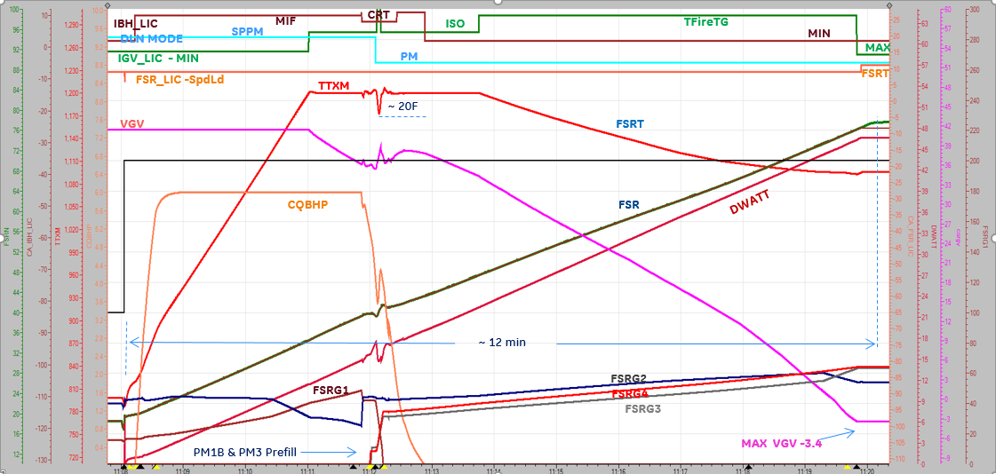
Nominal Operation Effector – Loop Sequence Cycle Control
Start to FSNL – Start UP Control (SUC)
Sync– Base load (CMBC)
FSR – Firing->Acceleration/Min->FSRN
IGV – Min
IBH – Min
SPLITS – Per mode sequence
FSR – FSRN -> FSRT
IGV – Min -> ISO -> Tfire TG -> Max
IBH – Min ->Max Flow ->CRT ->Min
SPLITS – Per mode sequence ( function of CRT)
No ARES outputs are used
ARES outputs used
CRT, TFIRE, BFM,CM/U…

Slide 13
Quiz - 2
What does ARES stand for ?
Adaptive Real-time Engine Simulation
Accurate Real-time Estimated Solution
Adaptive Real-time Engine Solution
Adjusted Robust Engine Simulation
ANSWER:
Adaptive Real-time Engine Simulation

Slide 14
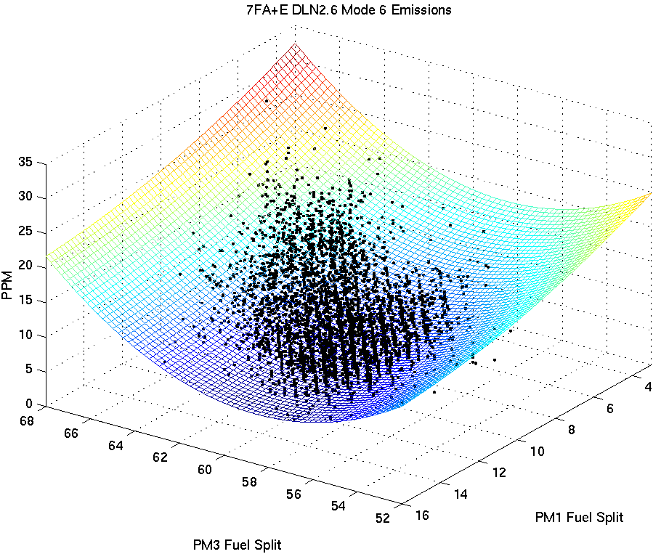
Model-Reference Adaptive Control
Gas Turbine
Commands
Model-Based
Control Structure
(Loop Selection Logic)
Effectors
Boundary Scheduling Logic
Boundary/ Targets
Errors
+
_
Combustion Dynamics Measurement
* Emissions
Measurement
TF Tuning
Estimated Boundary Levels
Surrogates
ARES - Parameter
Estimation
Boundary Transfer Functions
Engine Model
* Closed-Loop Emissions Sensor Part of Development Test Engine(s) – Potentially AO

Slide 15
Gas Turbine Control Objectives
What are my control objectives?
Objectives change per operating mode
Focusing on Gas Fuel, Pre-selected Load operation:
Deliver requested power
Contribute to grid frequency regulation
Minimize heat rate
Allow Flexibility
Utilize combustion operability
Minimize dynamics
Minimize emissions
Maximize efficiency
Of course don’t blow out
Standard Droop Speed/Load Control shown:
What are my noise/disturbance parameters/events?
Again, different per operating mode
Focusing on Gas Fuel, Pre-selected Load operation:
Grid frequency upsets
Fuel pressure, temperature, composition upsets
Swings in compressor inlet conditions (ambient, fogging, chillers, steam heating)
Sensor / effector faults
others…

Slide 16
Model-Based Control v/s CPC
Indirect (Tx Space) Boundary Control
Approximate Boundary Protection (Accommodate Worst-Case Condition)
No Explicit Accommodation Of Machine Deterioration (New & Clean / Mean Machine Assumption)
Coupled Effectors Prohibit Optimization (Part-Load Exhaust Temperature & Fuel Splits)
TTRF ~ Tx
Fuel
Splits
Splits
CPR
TCD
TTRF
SH
CPC
Algorithm
W_fuel
/ IGV
Tx_req
+
P+I
ΔP_{xx}
MINIMUM
-
Iso-Therm
Tx
MBC : Direct (Boundary Space) Boundary Control
_
+
Loop-In-Control
IGV
Direct Boundary Protection (In The Boundaries Physical Space)
Accommodation Of Machine Deterioration (Adaptive Model Ensures Accurate Surrogates)
Implicitly De-Coupled Effectors (Automatic Performance Optimization)
Robust / Flexible / Expandable (Additional Boundaries / Loops)
Proven GT Control Technology
_
+
_
_
+
Limit Scheduling
+
Loop-In-Control
W_fuel
_
+
_
Fuel Splits
+
_
+
Loop-In-Control
_
+
_
+
Physics-Based Boundary Models
Surrogates
ARES - Parameter
Estimation
Engine Model

Slide 17
Load Path to Variable Load Path
Mode 6, Emission Compliant
Max. T exh
Auto-tune Enabled
ALAT
Increased fuel
flexibility
Combined Cycle Path
Constant CRT
T-Exh
FLP
Increased
operational
flexibility
Constant CRT
Simple Cycle Path
GT base load
Next Gen Plant optimization
Optimized plant
startup/ operation
Min. T- exh
GT Load
Key Enablers for VLP
All Load Auto tune
Feed Forward CAF
Schedule Less Mode Transfers

Slide 18
All-load Autotune
MBC
Mode 6,
Emission Compliant
Max. T exh
Auto-tune Enabled
Emissions /dynamics
reference
combustion models
Autotune
Control
Structure
Combined Cycle Path
T-Exh
DLN Splits
Autotune
Simple Cycle Path
Temperature /
load reference
ALCC
Control
Structure
IGV
GT base load
FSR
IBH
Min. T- exh
Cycle control
GT Load
ARES – GT model
Parameter estimation
All load Autotune
Max. T exh
Extend scope of DLN split control below mode 6
Breaker closure – Base load
Envelope between SC and CC paths
Auto-tune
Enabled Operating Envelope
T-Exh
Benefits
Accommodates gas composition variation
Lower cost than variable fuel heater
Key enabler for Variable Load Path implementation
GT base load
Min. T- exh
GT Load

Slide 19
Co-ordinated Air Fuel - CAF
Traditional MBCAF
Downsides of Current Model-Based CAF
Offline-Generated Path for IGVs (from GTP)
Map is path dependent
Map does not adjust real-time if temps go high/low
Map is based on steady-state data
Next Gen Model-Based FFCAF Concept
FSR + Δ
ARES
Model
mdl
ΔTfire
ΔTexh
Partial
Derivative
Calc
IGV-FF
Feed-forward term to Temp control loops
Based on idea to move IGV’s so as to counteract temperature impact of FSR
IGV + Δ
Expected Benefits
Feedforward term independent of load path
Feedforward term updated real-time based upon actual engine conditions
Combining with Temp control feedback loops will allow for real-time adjustment if/when temps vary from targets/boundaries
Potential to eliminate triggering logic and improve control during normal operation

Slide 20
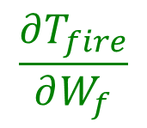
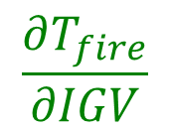
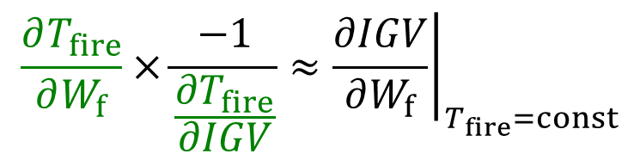

Feed Forward Calculation
Ex: Tfire, can be done for any ARES output
New ARES model perturbations calculate:
How much Tfire changes with respect to fuel flow and IGV at current conditions
ARES derivatives used to calculate feed forward:
How much IGV movement per unit change in fuel flow will keep Tfire constant
FF output
+
Controller output
FF
Feed Forward Term
+
C
+
G
Targets/ Boundary
-
Sensor outputs
OR
Model outputs

Slide 21
Mode Transfer Strategy
When To Transfer?
Option 1: Fixed CRT
Transfer? = f (CRT) Current method
How To Transfer?
Option 1: Autotune → Split schedule → Autotune Current method
Option 3: Autotune → Steady State Sol. → Autotune ALAT method

Slide 22
Mode Transfer in All Load Autotune
Comb. transfer function
MODE X
PI REG
Priority Selection logic
Mode select logic
Ref
Fd.Bck.
Splits ( in control)
Int_IN
SLEW LOGIC
Splits
Mode X
Splits
Corr. Splits
Fuel system Model
GT model
Manifold differential
pressure transducer
Comb. transfer function
MODE Y
PI REG
Priority Selection logic
Ref
Corr. Splits
Fd.Bck.
Splits (Not in Control)
Mode select logic
Int_IN
Splits
Mode Y
Splits (Not in Control)

